Slide 1
Application and challenges of green Iot
Presented by
191CS129 & Ashwin .R.A
191CS103 & Abhi Nivesh.L

Slide 2
Contents:
Abstract
Architecture of green IoT
Technologies for green IoT
Internet of things for smart cities
Advantages of green IoT
Developments in green IoT
Challenges
Future research directions
Conclusion

Slide 3
Abstract:
IoT is that things which can communicate with each other without human.
Due to the huge and rapid developments in science and technology ,the world is becoming smart.
IoT targets at connecting various objects with some unique addresses , to enable them interacting with each other and the world.
Further green IoT targets at sustainable smart world, by reducing the energy consumption of IoT.

Slide 4
Problem Statement Addressed:
At present IoT is faced with many challenges Such as
Scalability
Technological Standardization
Inter Operability
Discovery
Software Complexity
Power supply
Interaction and short range communication
Fault tolerance

Slide 5
Existing Solution to the Problem Addressed:
IoT has taken over the automobile sectors very effectively. For example we can take the Google waymo , it is the fully automated car which does not requires any driver assistance .
Some common developments were encouraged to attain agricultural sustainability.
Projects using IoT for maximizing renewable energy technologies are developed.
IoT tools used to supervise the environmental changes.

Slide 6
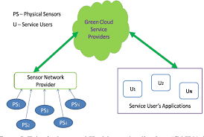
Architecture of green IoT:

Slide 7
Technologies for green IoT
Identification technologies
Cloud platform
Network technologies
Software and algorithms
Hardware
Data and signal processing technologies
Power and energy storage technologies

Slide 8
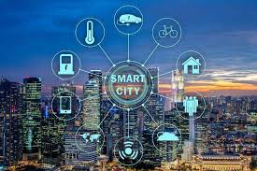
IoT for smart cities:
Smart home
Industrial automation
Smart health care
Smart grid

Slide 9
Advantages of green IoT:
Does not emit anything harmful into the air
Can bring economic benefits to certain areas.
Requires less maintenance so you don’t have to shell out a lot of money to operate it .
Renewable which means we will never run out.
Can slow the effects of global warming by reducing CO2 Emissions.

Slide 10
Future research directions
The future of IoT has the potential to be limitless.
This will enable new opportunities within remote learning, surgery and repair. Immersive mixed reality applications have the potential to become the next platform after mobile – realized through 3D audio and haptic sensations and becoming our main interface to the real world. Bringing future IoT to life will require close synergy between the IoT- and network platforms. This continues to be a key focus area of Ericsson research.

Slide 11
REFERENCE:
1. S. H. Alsamhi1 , Ou Ma2 , M. Samar Ansari3 , Qingliang Meng4,” Greening Internet of Things for Smart Everythings with A GreenEnvironment Life: A Survey and Future Prospects”.
2. C. Zhu, V.C. Leung, K. Wang, L.T. Yang, Y. Zhang, MultiMethod Data Delivery for Green Sensor-Cloud, IEEE Communications Magazine

Slide 12
Thank you

